Slide 1


QUPP RHD NIPT
RHD non‑invasive prenatal testing (NIPT)
for
fetal RhD blood group prediction in pregnancy

Slide 2

ABO & RhD Blood Group System and Pregnancy
Major blood groups
  ABO and Rh
Rh blood system
  antigens D, c, C, e, E
  partly determined by ethnicity
RhD negative or positive
Inherited from the mother and father
Notes:
Hundreds of blood groups and variants within these groups
ABO and Rh are the most commonly referred to groups, as these are the most important in relation to immunogenicity and ability to mount a significant immune response and development of antibodies in transfusion of fresh blood components and during pregnancy. This is why this is the Rh system is clinically significant in pregnancy as a baby’s blood group is determined by both parents and can therefore be different to the mother.

Slide 3
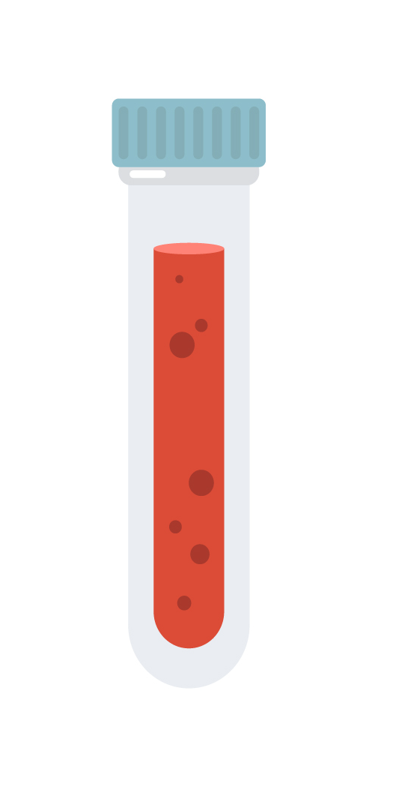
Blood group and antibody screen
Generally completed during the first antenatal trimester
Determine the mother’s ABO and RhD blood group
Identify existing antibodies which may be of clinical significance (D, e, E, C, c, K, Fy)
  transfusion exposure or previous pregnancies
Repeated at 28 weeks for RhD negative mothers

Slide 4

Anti-D antibodies
  Only RhD negative women can develop anti-D antibodies
  RhD positive women do not make anti-D antibodies
  RhD positive fetuses in a mother with anti-D antibodies are therefore at risk of HDFN
  Anti-D antibodies generally, do not cause harm during the pregnancy in which they are developed
  Anti-D antibodies were the most common antibodies identified in severe HDFN prior to RhD Ig prophylaxis
Notes:
Hundreds of blood groups and variants within these groups
ABO and RH are the most commonly referred to groups, as these are the most important in relation to immunogenicity and ability to mount a significant immune response and development of antibodies in transfusion of fresh blood components and during pregnancy.
RhD is the most common antigen within the Rh system that results in HDFN. RhD negative women can develop antibodies to RhD (anti-D antibodies) if they are pregnant with a RhD positive baby as some of the baby’s blood can cross the placenta and mount an immune response. It usually does not impact the current pregnancy, but may affect future pregnancies with a RhD positive baby. The antibodies can cross the placenta and damage the baby red cells

Slide 5
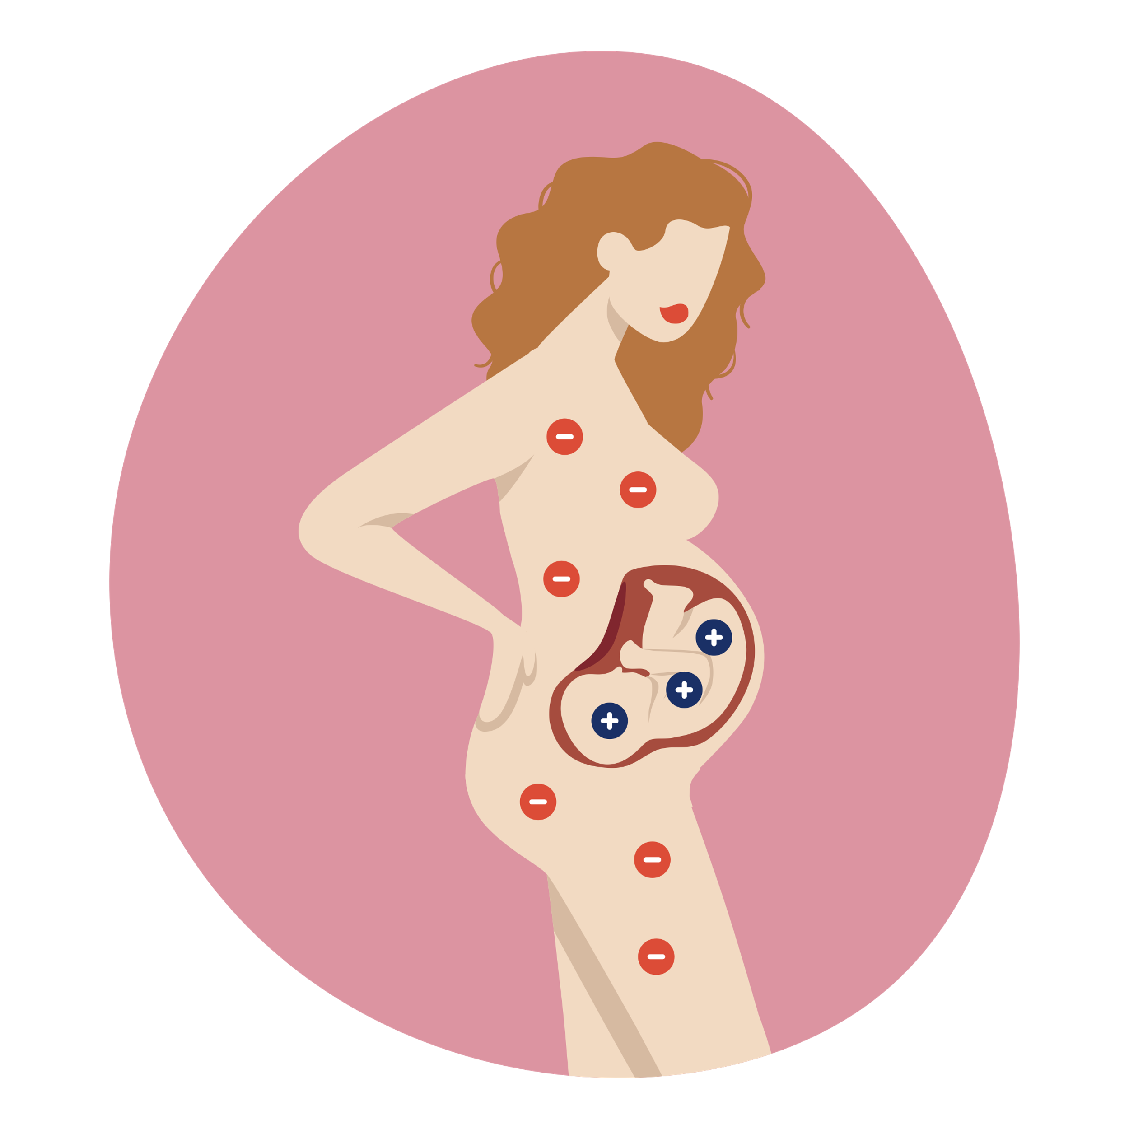
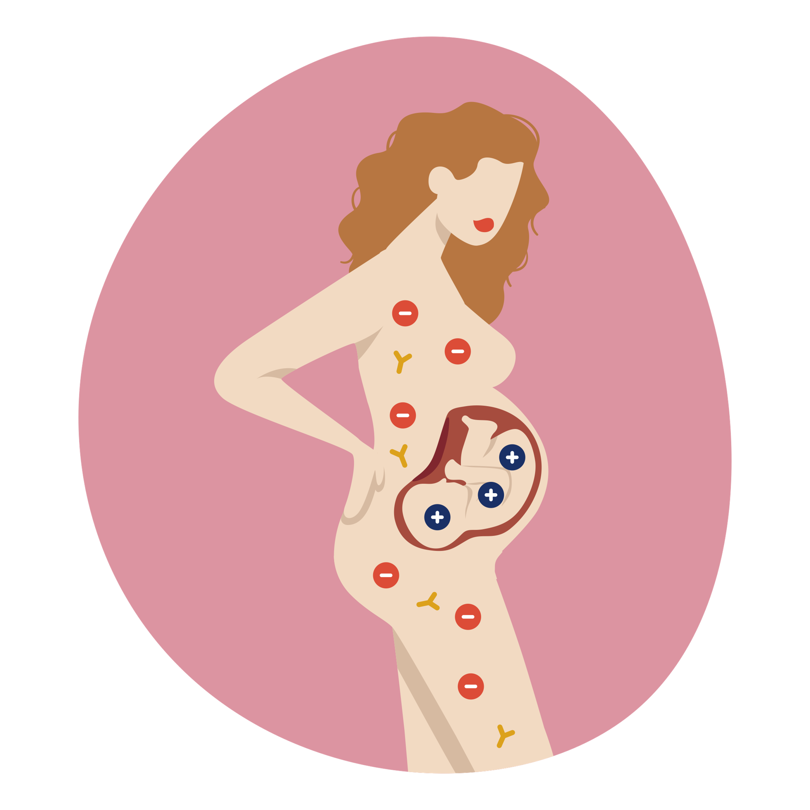
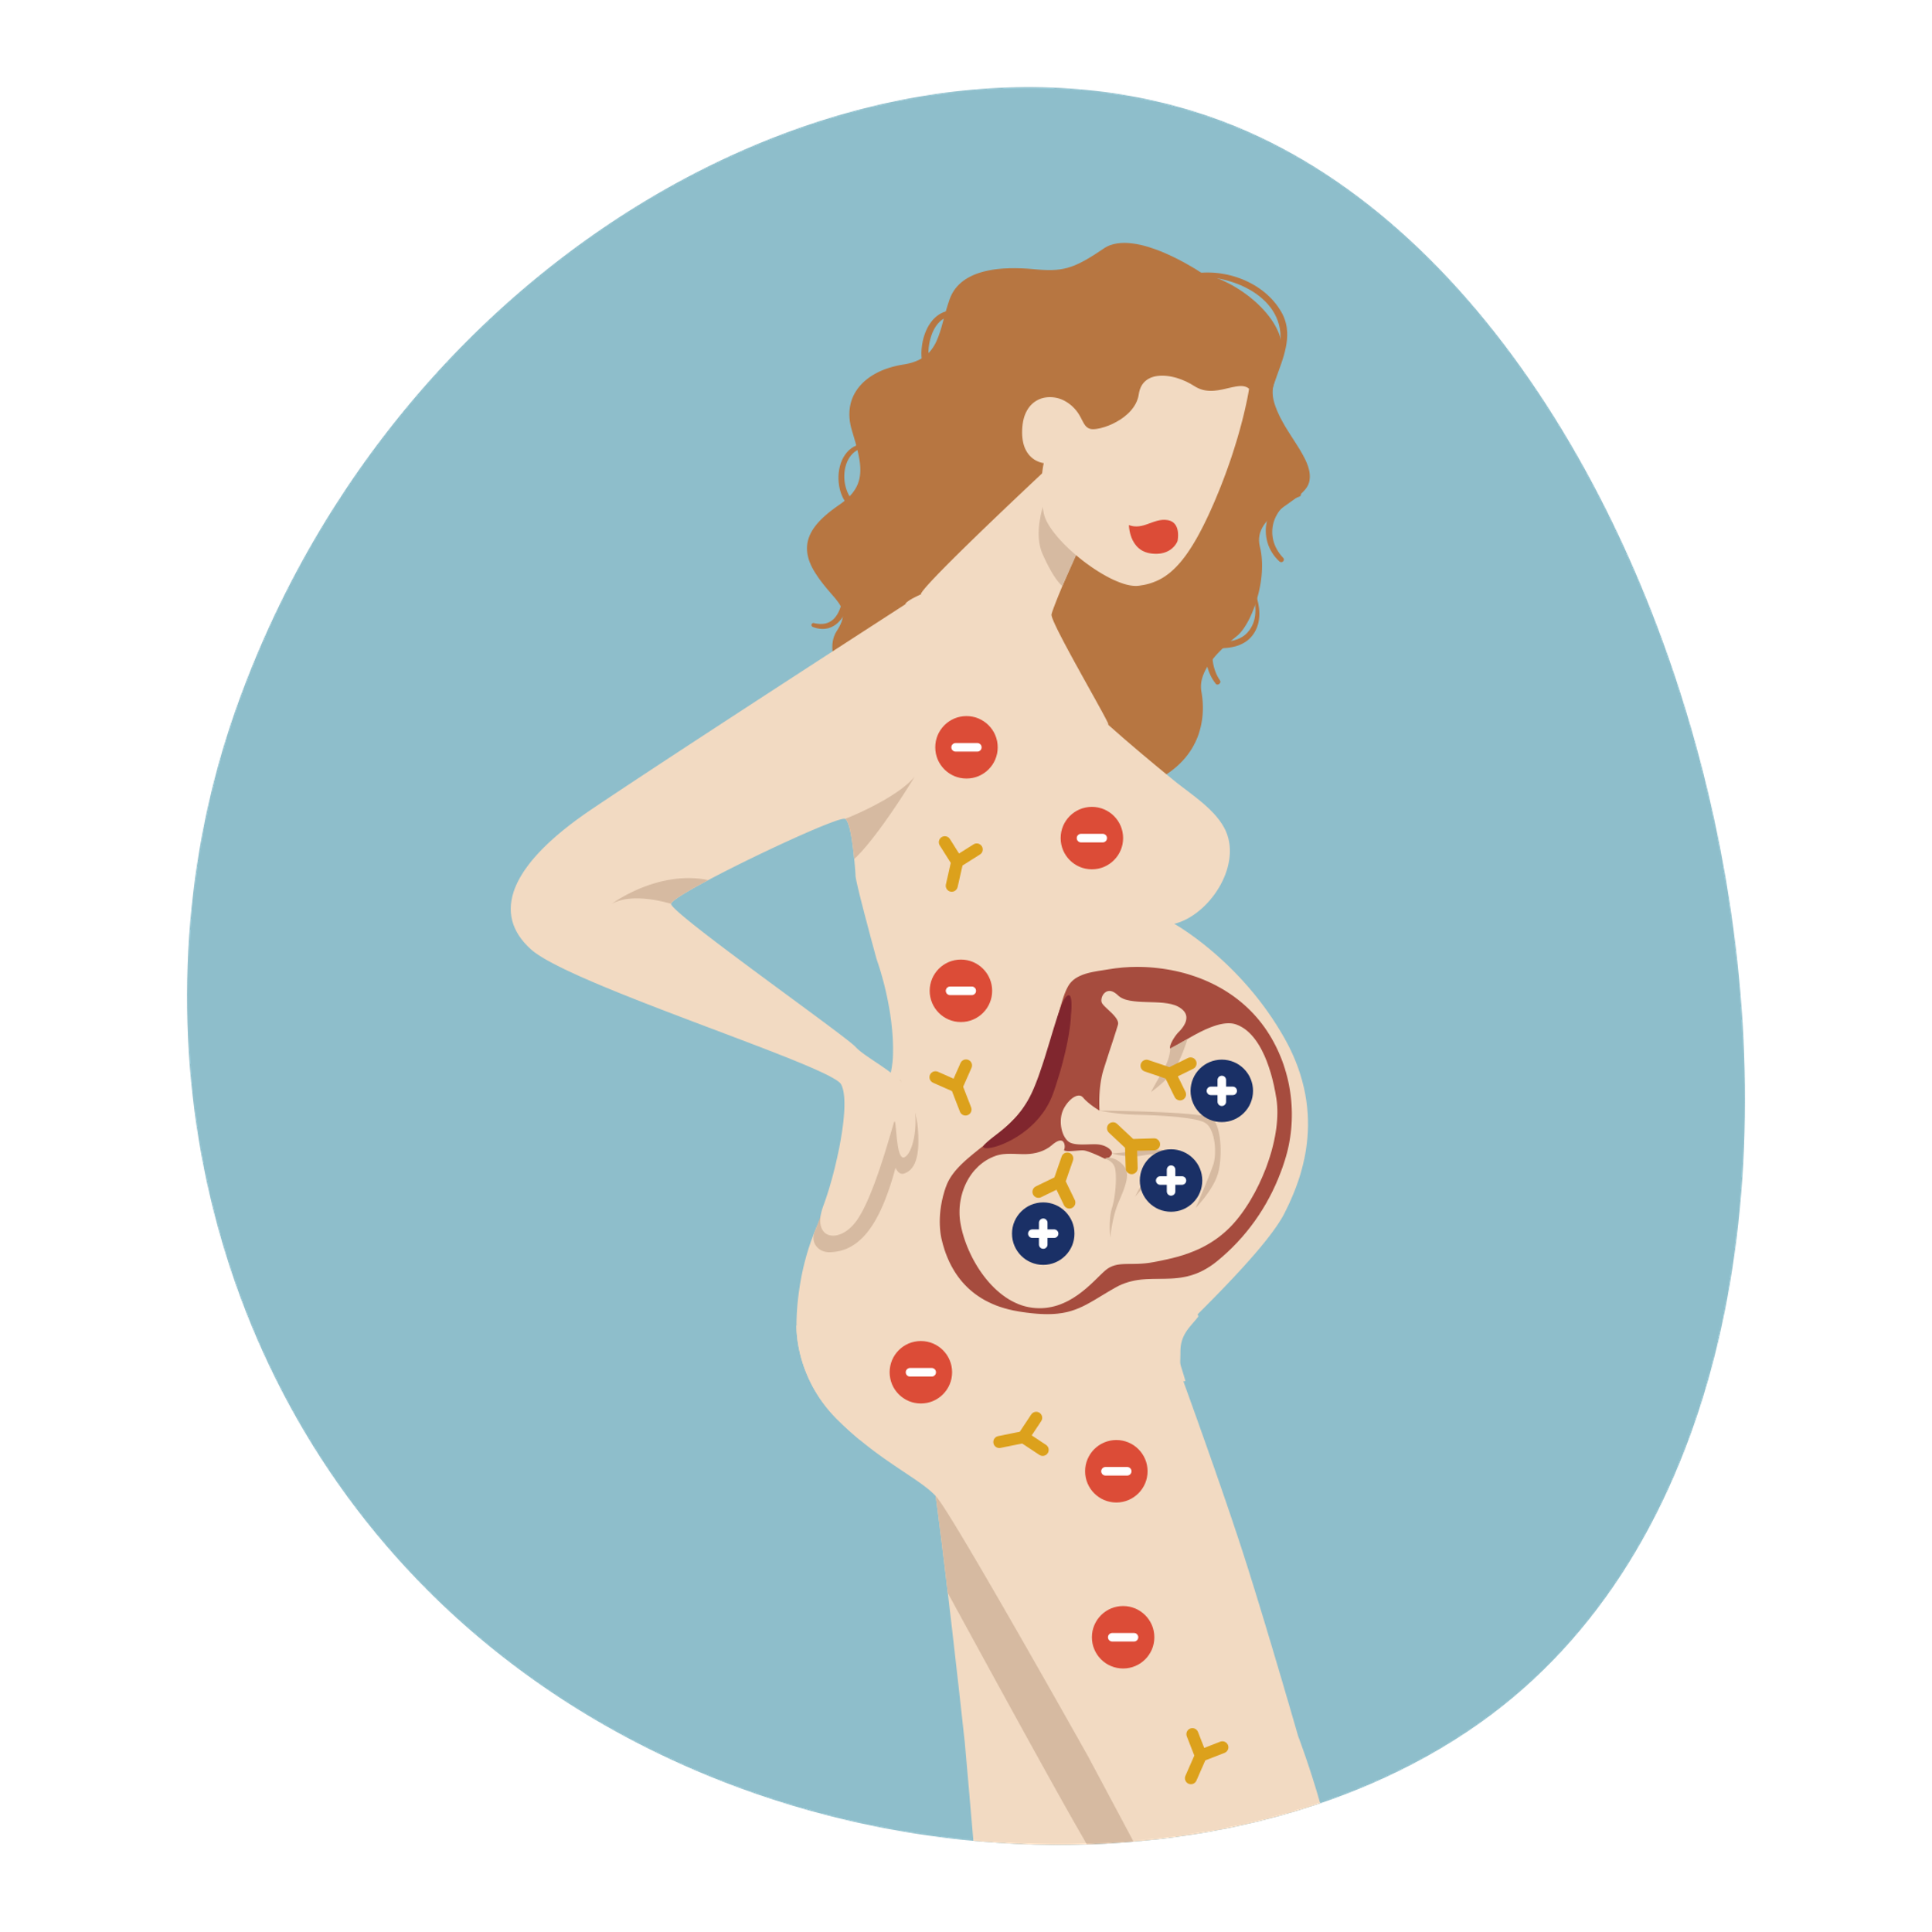
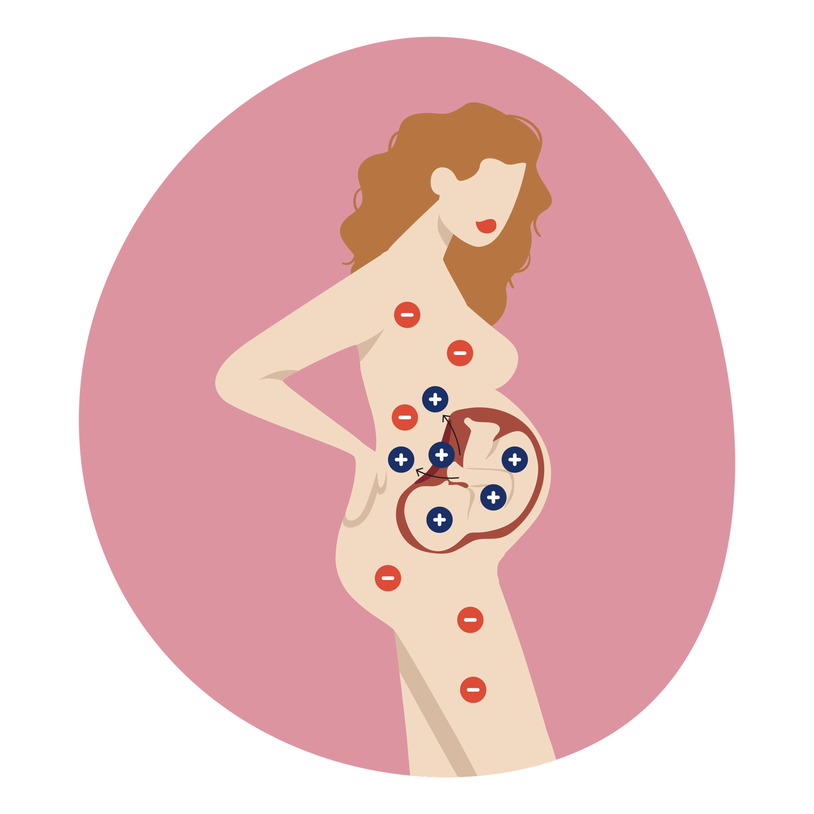

Haemolytic disease of the fetus and newborn (HDFN)
RhD negative mother & RhD positive fetus
RhD positive fetal red cells cross the placenta into the mother’s circulation
RhD negative mother develops antibodies
(anti-D)
Anti-D IgG antibodies can cross back over the placenta and destroy the fetal red cells
Notes:
Cause – usually anti-D antibodies due to RhD negative mother, RhD positive fetus
RhD positive red cells cross the placenta and lead to the mother’s immune system developing anti-D antibodies. These can then cross the placenta in subsequent pregnancies and destroy the fetal red cells. Causing severe anaemia, jaundice, brain damage and potentially death
Prevalence – Caucasian 15% RhD negative – 60% of these will be carrying a RhD positive fetus
Prevention – RhD Ig prophylaxis for all RhD negative women (discussed in next slide)
Management – Intrauterine transfusion / exchange early delivery/ specialist monitoring

Slide 6
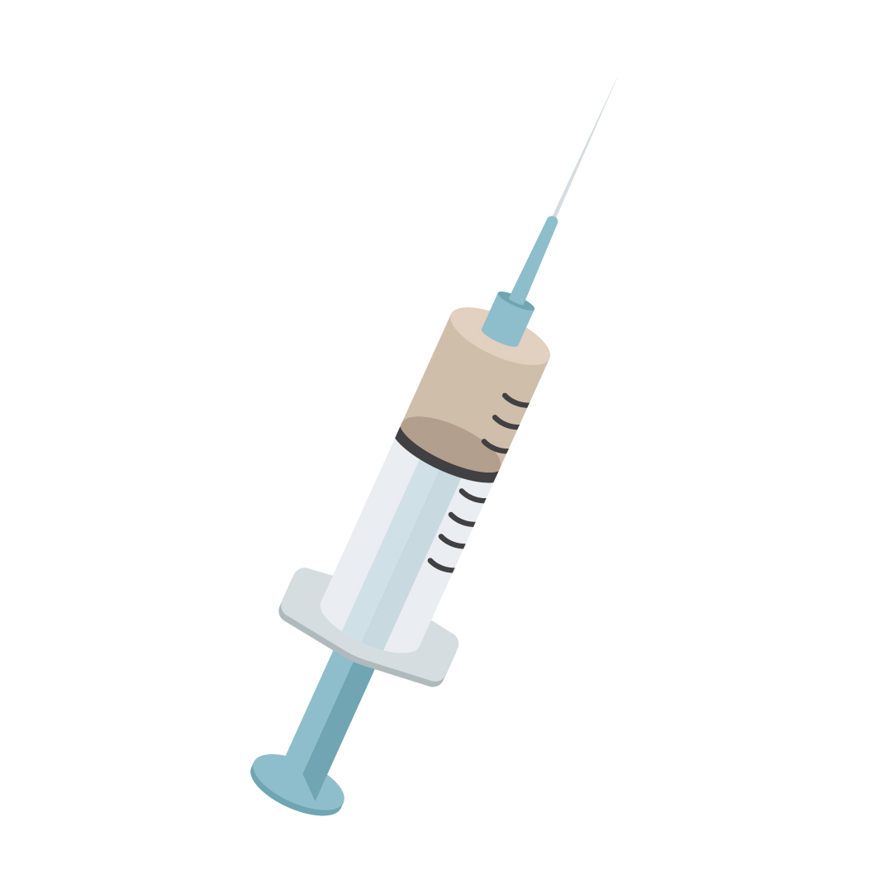
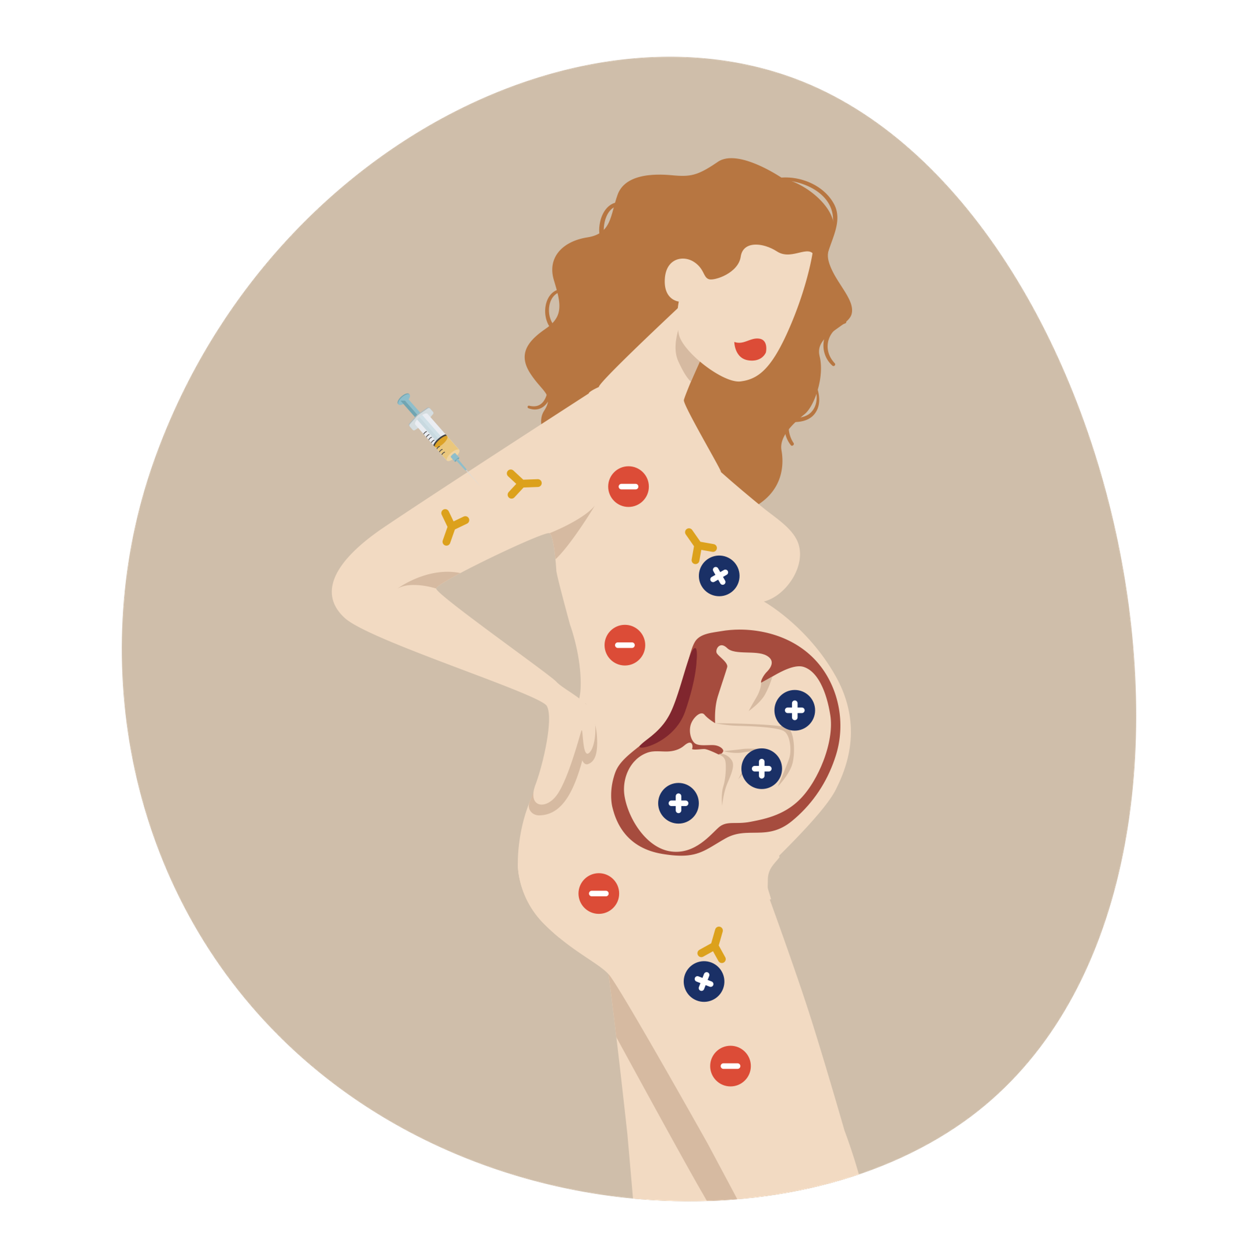
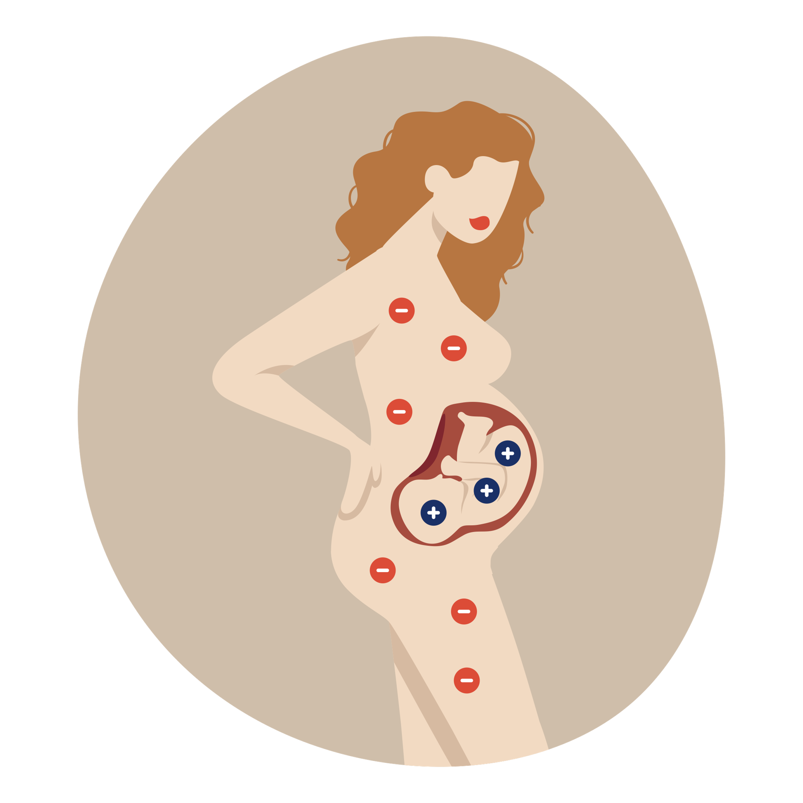

RhD Immunoglobulin (Ig)
RhD negative mother & RhD positive fetus
RhD Ig injection given to prevent anti-D antibodies from developing in the mother
Prevents the mother developing anti-D antibodies & limits development of HDFN
Notes:
Derived from blood plasma and therefore requires a written consent prior to administration
Important for subsequent pregnancies

Slide 7
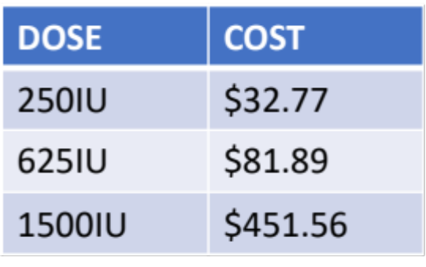
RhD Immunoglobulin (Ig)
Derived from human plasma
Male donors are injected with small volume of RhD positive blood and those that develop anti-D antibodies then donate their plasma
Plasma is then sent for processing and manufacture of RhD Ig
Cost (funded by Australian healthcare system)
Notes:
A small donors pool and this leads to difficulty in sustaining supply
Cost relates only to the product (not related to staff to administer)
Large doses (above 1500IU) given IV

Slide 8
Currently all RhD negative women receive prophylaxis RhD Ig
Assumes that the baby is RhD positive until birth and a cord blood test confirms otherwise
Currently RhD Ig given to all RhD negative women at:
  28 weeks & 32 weeks
  following sensitising events
  and following cord blood test that confirms the baby is RhD positive
40% of RhD negative women will have an RhD negative baby
Notes:
40% - meaning 40% of these women do not actually require RhD Ig

Slide 9
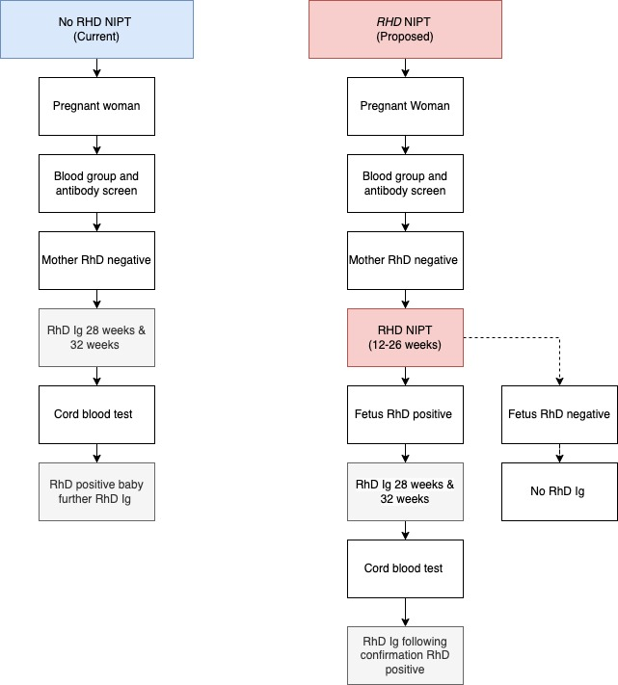
Pregnancy care with the introduction of RHD NIPT

Slide 10


RHD NIPT
Sample contains fetal and maternal DNA
Fetal DNA fraction is used to determine the fetal RhD blood group
Maternal blood sample collected
(12-26 weeks gestation)
Specimen sent for processing
Notes:
Simple maternal blood test
Between 12-26 weeks (up to 32 weeks)
Cannot be before 12 weeks
Before 26 weeks ideally to allow for RhD Ig at 28 weeks
Maternal sample contains fragments of cffDNA and this is extracted and analysed to determine the RhD fetal blood group
Multiparous woman also included

Slide 11


Consent – RHD NIPT
Informed consent
Information provision
Risks and benefits
% accuracy
Notes:
Informed consent – language considerations and use of interpreters or translation of resources to enable informed consent
No written consent required – attendance to have test complete assumes consent
No genetic screening
Risks of false positive, false negative, inconclusive and the need to have prophylaxis RhD Ig

Slide 12

RhD Immunoglobulin (Ig) use guided by RHD NIPT
RhD negative mother
  RhD positive fetus
  inconclusive fetal results
  following sensitising events
  following cord blood sample confirming RhD positive baby

Slide 13
Specimen collection for RHD NIPT
Request form
Specimen tube
  Streck or EDTA
  volume, storage and order of draw
Minimum requirements for testing
  labelling
  identical patient details
  EDD
Patient identifiers (patient identification)
  WBIT
Notes:
Form
Must contain EDD that indicates 12-26 weeks (up to 32 weeks)
Collector details – important if specimen does not meet requirements for tesing
Date and time of collection
Minimum 3 patient identifiers (name, DOB, address or MRN)
Tube
Seek provider specific (volume, number and type of tube, order of draw)
Minimum 2 identifiers check against form and patient details
Do not open
Min Requirements
Where there is any issues/errors, the sample will be rejected. This is because any requirements not met provide an opportunity for an incorrect result.
EDD – Estimated due date – most correspond with 12-26 weeks gestation at time of collection
Patient identification
WBIT – checking that the details on the patients ID band (or verbal confirmation) against form and tube.

Slide 14
Result fetal RhD prediction | Rationale | Management
RhD negative |  | No RhD Ig prophylaxis is required
RhD positive |  | RhD Ig prophylaxis is recommended for 28 & 34 weeks, following a sensitising events, and again at birth following a cord blood test confirming a RhD positive baby.
Inconclusive | For a small number of women (<5%) the result will be reported as inconclusive where there is insufficient fetal DNA or the mother may have a partial D blood group. | The woman should receive RhD Ig at 28 & 34 weeks, following sensitizing events and then again at the birth of the baby if a cord blood test confirms a RhD positive baby.
Not reported | Did not meet minimum acceptance requirements (haemolysed, insufficient volume, mismatched details or EDD <12 weeks) | Consider offering a retest if the woman is < 26 weeks (may be offered up to 32 weeks) The woman should receive RhD Ig at 28 & 34 weeks, following sensitizing events and then again at the birth of the baby if a cord blood test confirms a RhD positive baby.
Results RHD NIPT

Slide 15
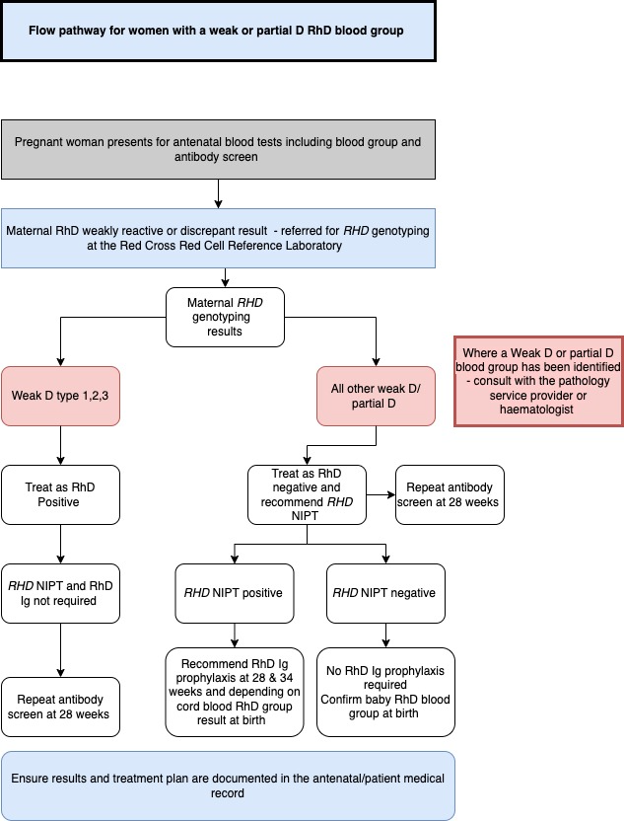
Weak or Partial D
May or may not be capable of producing antibodies
Consult with pathology provider or haematologist, if a maternal weak or partial D is identified
Maternal weak D
  Type 1,2,3 treat as RhD Positive
  Other types of weak RhD offer RHD NIPT
Partial
  Treat as RhD negative and offer RHD NIPT

Slide 16
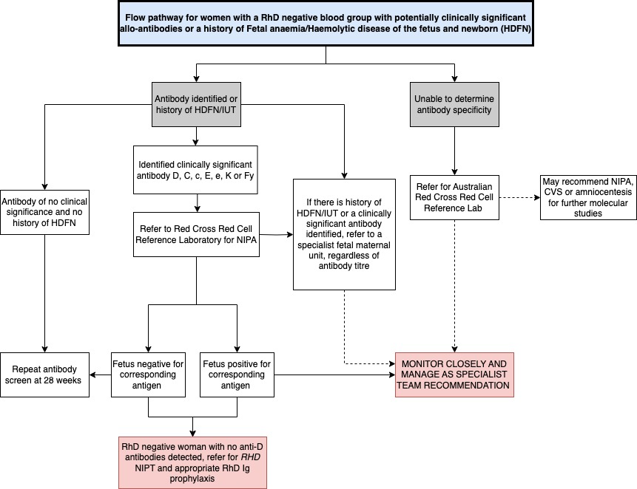
Clinically Significant Antibodies or History HDFN
Clinically significant Abs
  D, C, c, E, e, K, Fy
  Refer for ARCLB service for NIPA
All clinically significant antibodies and/or history of HDFN refer to a specialist fetal maternal unit
No anti-D antibodies
  refer RHD NIPT and/or RhD Ig prophylaxis
Notes:
All women with clinically significant antibodies or history of HDFN should be referred to a specialist fetal maternal unit, regardless of titre.
Women with antibodies other than D are capable of developing anti-D antibodies and should have RHD NIPT / RhD Ig prophylaxis

Slide 17
Q&A
What do I do if the specimen cannot be tested or the report is not available?
If <26 weeks consider a retest or offer RhD Ig prophylaxis
If >26 weeks – contact the woman and explain that the result is not available. Offer RhD Ig prophylaxis at 28 and 34 weeks and again at birth if the cord blood sample determines the baby to be RhD positive.

Slide 18
Q&A
What happens if a woman is given a false positive result?
The test is very accurate with less than 2 in 100 women reported as a false positive (these women will be given RhD Ig which is the same as the current practice without RHD NIPT availability). The false result is identified following cord blood testing.
What happens if a women is given a false negative result? (RhD positive fetus predicted as RhD negative)
Less than 1 in 1000 women will receive a false negative result (RhD positive fetus predicted to be RhD negative). A cord blood is collected at birth where this discrepancy will be identified and RhD Ig recommended to reduce the risk of HDFN for future pregnancies to 1%

Slide 19
Q&A
What do I do if a women presents following a sensitising event and the result is not yet available?
Contact the provider and ask whether the specimen has been tested and whether a result is likely to be available within the required time or already available but report not yet finalised.
If not yet available or unlikely to be available within the required timeframe – offer RhD Ig as per fetal-maternal haemorrhage (FMH) procedure/policy/guideline
What do I do if a RhD negative woman presents following a sensitising event at 20-24 weeks and has not yet had the RHD NIPT test completed?
Contact the provider and ask if the test might be able to be processed urgently. If possible and likely to be available within 72 hours, consider rebooking the women for +/- RhD Ig pending the RHD NIPT result.
Determine FMH volume by Kleihauer or flow cytometry
What do I do if the women presents following a sensitising event between 12-20 weeks?
Manage as per FMH policy

Slide 20
Q&A
Can the test be added to the NIPT test for genetic screening?
No – the RHD NIPT test is a separate test that only tests for the RhD fetal status. Neither test is interchangeable.
How much does the test cost?
The test is funded by Medicare and the government.

Slide 21

Questions?

